Slide 1

Sheet 2: Search Blind Search
Eng. Abdulrahman ElMadkhoum

Slide 2
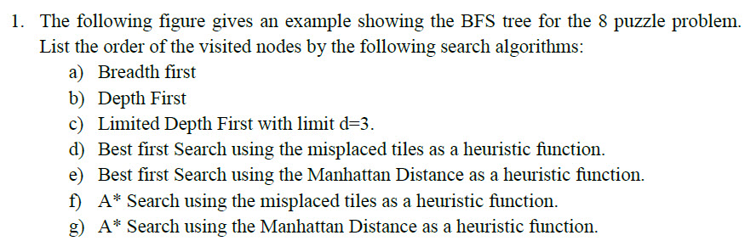
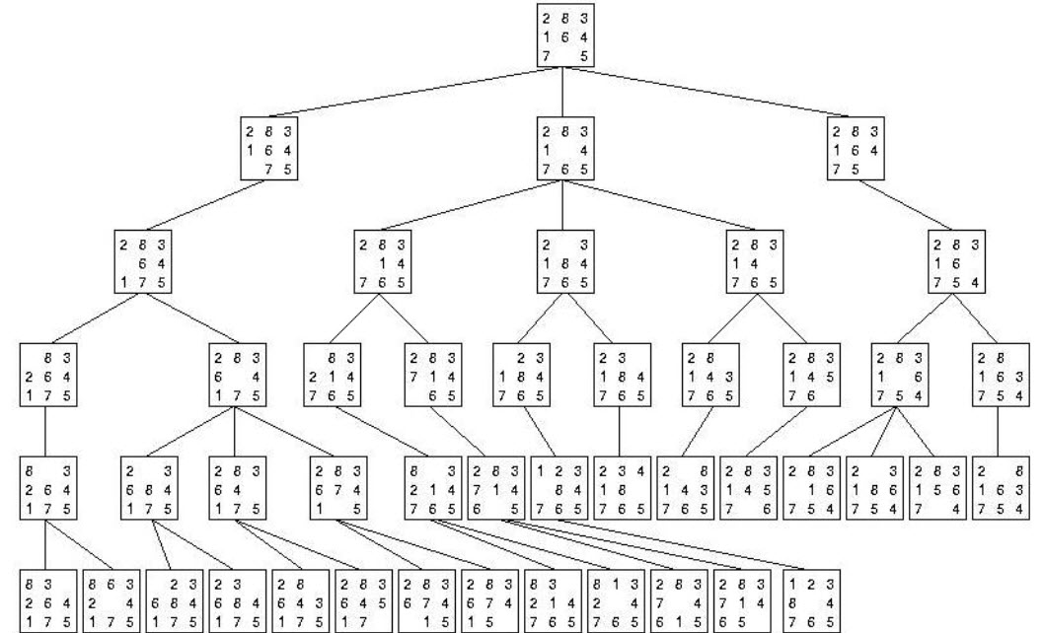

Slide 3
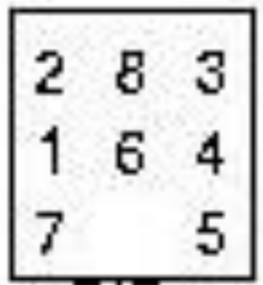
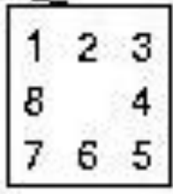
Initial State
Goal State

Slide 4
1-Breadth-first search
Breadth-first is blind search Moves from left to right, level by level until reaching the Goal

Slide 5
A
B
C
D
Order : A ,

Slide 6
A
B
C
D
E
Order : A , B ,

Slide 7
A
B
C
D
E
F
G
H
Order : A , B , C

Slide 8
A
B
C
D
E
F
G
H
I
Order : A , B , C ,D

Slide 9
A
B
C
D
E
F
G
H
I
J
K
Order : A , B , C ,D , E

Slide 10
A
B
C
D
E
F
G
H
I
J
K
L
M
Order : A , B , C ,D , E , F

Slide 11
A
B
C
D
E
F
G
H
I
J
K
L
M
N
O
Order : A , B , C ,D , E , F ,G

Slide 12
A
B
C
D
E
F
G
H
I
J
K
L
M
N
O
P
Q
Order : A , B , C ,D , E , F ,G , H

Slide 13
A
B
C
D
E
F
G
H
I
J
K
L
M
N
O
P
Q
R
S
Order : A , B , C ,D , E , F ,G ,H,I

Slide 14
A
B
C
D
E
F
G
H
I
J
K
L
M
N
O
P
Q
R
S
T
Order : A , B , C ,D , E , F ,G , H, I, J

Slide 15
A
B
C
D
E
F
G
H
I
J
K
L
M
N
O
P
Q
R
S
T
U
V
W
Order : A , B , C ,D , E , F ,G , H, I, J, K

Slide 16
A
B
C
D
E
F
G
H
I
J
K
L
M
N
O
P
Q
R
S
T
U
V
W
X
Order : A , B , C ,D , E , F ,G , H, I, J, K ,L

Slide 17
A
B
C
D
E
F
G
H
I
J
K
L
M
N
O
P
Q
R
S
T
U
V
W
X
Y
Order : A , B , C ,D , E , F ,G , H, I, J, K ,L, M

Slide 18
A
B
C
D
E
F
G
H
I
J
K
L
M
N
O
P
Q
R
S
T
U
V
W
X
Y
Z
Order : A , B , C ,D , E , F ,G , H, I, J, K ,L, M,N

Slide 19
A
B
C
D
E
F
G
H
I
J
K
L
M
N
O
P
Q
R
S
T
U
V
W
X
Y
Z
a
Order : A , B , C ,D , E , F ,G , H, I, J, K ,L, M,N,O

Slide 20
A
B
C
D
E
F
G
H
I
J
K
L
M
N
O
P
Q
R
S
T
U
V
W
X
Y
Z
a
b
Order : A , B , C ,D , E , F ,G , H, I, J, K ,L, M,N,O,P

Slide 21
A
B
C
D
E
F
G
H
I
J
K
L
M
N
O
P
Q
R
S
T
U
V
W
X
Y
Z
a
b
c
Order : A , B , C ,D , E , F ,G , H, I, J, K ,L, M,N,O,P,Q

Slide 22
A
B
C
D
E
F
G
H
I
J
K
L
M
N
O
P
Q
R
S
T
U
V
W
X
Y
Z
a
b
c
d
e
f
Order : A , B , C ,D , E , F ,G , H, I, J, K ,L, M,N,O,P,Q ,R

Slide 23
A
B
C
D
E
F
G
H
I
J
K
L
M
N
O
P
Q
R
S
T
U
V
W
X
Y
Z
a
b
c
d
e
f
h
Order : A , B , C ,D , E , F ,G , H, I, J, K ,L, M,N,O,P,Q,R,S

Slide 24
A
B
C
D
E
F
G
H
I
J
K
L
M
N
O
P
Q
R
S
T
U
V
W
X
Y
Z
a
b
c
d
e
f
g
h
i
Order : A , B , C ,D , E , F ,G , H, I, J, K ,L, M,N,O,P,Q,R,S ,T

Slide 25
A
B
C
D
E
F
G
H
I
J
K
L
M
N
O
P
Q
R
S
T
U
V
W
X
Y
Z
a
b
c
d
e
f
g
h
i
j
k
Order : A , B , C ,D , E , F ,G , H, I, J, K ,L, M,N,O,P,Q,R,S ,U

Slide 26
A
B
C
D
E
F
G
H
I
J
K
L
M
N
O
P
Q
R
S
T
U
V
W
X
Y
Z
a
b
c
d
e
f
g
h
i
j
k
l
m
Order : A , B , C ,D , E , F ,G , H, I, J, K ,L, M,N,O,P,Q,R,S ,U,V

Slide 27
A
B
C
D
E
F
G
H
I
J
K
L
M
N
O
P
Q
R
S
T
U
V
W
X
Y
Z
a
b
c
d
e
f
g
h
i
j
k
l
m
n
o
Order : A , B , C ,D , E , F ,G , H, I, J, K ,L, M,N,O,P,Q,R,S ,U,V,W

Slide 28
A
B
C
D
E
F
G
H
I
J
K
L
M
N
O
P
Q
R
S
T
U
V
W
X
Y
Z
a
b
c
d
e
f
g
h
i
j
k
l
m
n
o
p
q
Order : A , B , C ,D , E , F ,G , H, I, J, K ,L, M,N,O,P,Q,R,S ,U,V,W,X

Slide 29
A
B
C
D
E
F
G
H
I
J
K
L
M
N
O
P
Q
R
S
T
U
V
W
X
Y
Z
a
b
c
d
e
f
g
h
i
j
k
l
m
n
o
p
q
r
s
Order : A , B , C ,D , E , F ,G , H, I, J, K ,L, M,N,O,P,Q,R,S ,U,V,W,X,Y

Slide 30
A
B
C
D
E
F
G
H
I
J
K
L
M
N
O
P
Q
R
S
T
U
V
W
X
Y
Z
a
b
c
d
e
f
g
h
i
j
k
l
m
n
o
p
q
r
s
t
Order : A , B , C ,D , E , F ,G , H, I, J, K ,L, M,N,O,P,Q,R,S ,U,V,W,X,Y,Z

Slide 31
A
B
C
D
E
F
G
H
I
J
K
L
M
N
O
P
Q
R
S
T
U
V
W
X
Y
Z
a
b
c
d
e
f
g
h
i
j
k
l
m
n
o
p
q
r
s
t
Order : A , B , C ,D , E , F ,G , H, I, J, K ,L, M,N,O,P,Q,R,S ,U,V,W,X,Y,Z,a

Slide 32
A
B
C
D
E
F
G
H
I
J
K
L
M
N
O
P
Q
R
S
T
U
V
W
X
Y
Z
a
b
c
d
e
f
g
h
i
j
k
l
m
n
o
p
q
r
s
t
Order : A , B , C ,D , E , F ,G , H, I, J, K ,L, M,N,O,P,Q,R,S ,U,V,W,X,Y,Z,a,b

Slide 33
A
B
C
D
E
F
G
H
I
J
K
L
M
N
O
P
Q
R
S
T
U
V
W
X
Y
Z
a
b
c
d
e
f
g
h
i
j
k
l
m
n
o
p
q
r
s
t
Order : A , B , C ,D , E , F ,G , H, I, J, K ,L, M,N,O,P,Q,R,S ,U,V,W,X,Y,Z,a,b,c

Slide 34
A
B
C
D
E
F
G
H
I
J
K
L
M
N
O
P
Q
R
S
T
U
V
W
X
Y
Z
a
b
c
d
e
f
g
h
i
j
k
l
m
n
o
p
q
r
s
t
Order : A , B , C ,D , E , F ,G , H, I, J, K ,L, M,N,O,P,Q,R,S ,U,V,W,X,Y,Z,a,b,c ,d

Slide 35
A
B
C
D
E
F
G
H
I
J
K
L
M
N
O
P
Q
R
S
T
U
V
W
X
Y
Z
a
b
c
d
e
f
g
h
i
j
k
l
m
n
o
p
q
r
s
t
Order : A , B , C ,D , E , F ,G , H, I, J, K ,L, M,N,O,P,Q,R,S ,U,V,W,X,Y,Z,a,b,c,d,e

Slide 36
A
B
C
D
E
F
G
H
I
J
K
L
M
N
O
P
Q
R
S
T
U
V
W
X
Y
Z
a
b
c
d
e
f
g
h
i
j
k
l
m
n
o
p
q
r
s
t
Order : A , B , C ,D , E , F ,G , H, I, J, K ,L, M,N,O,P,Q,R,S ,U,V,W,X,Y,Z,a,b,c,d,e,f

Slide 37
A
B
C
D
E
F
G
H
I
J
K
L
M
N
O
P
Q
R
S
T
U
V
W
X
Y
Z
a
b
c
d
e
f
g
h
i
j
k
l
m
n
o
p
q
r
s
t
Order : A , B , C ,D , E , F ,G , H, I, J, K ,L, M,N,O,P,Q,R,S ,U,V,W,X,Y,Z,a,b,c,d,e,f,g

Slide 38
A
B
C
D
E
F
G
H
I
J
K
L
M
N
O
P
Q
R
S
T
U
V
W
X
Y
Z
a
b
c
d
e
f
g
h
i
j
k
l
m
n
o
p
q
r
s
t
Order : A , B , C ,D , E , F ,G , H, I, J, K ,L, M,N,O,P,Q,R,S ,U,V,W,X,Y,Z,a,b,c,d,e,f,g,h

Slide 39
A
B
C
D
E
F
G
H
I
J
K
L
M
N
O
P
Q
R
S
T
U
V
W
X
Y
Z
a
b
c
d
e
f
g
h
i
j
k
l
m
n
o
p
q
r
s
t
Order : A , B , C ,D , E , F ,G , H, I, J, K ,L, M,N,O,P,Q,R,S ,U,V,W,X,Y,Z,a,b,c,d,e,f,g,h,i

Slide 40
A
B
C
D
E
F
G
H
I
J
K
L
M
N
O
P
Q
R
S
T
U
V
W
X
Y
Z
a
b
c
d
e
f
g
h
i
j
k
l
m
n
o
p
q
r
s
t
Order : A , B , C ,D , E , F ,G , H, I, J, K ,L, M,N,O,P,Q,R,S ,U,V,W,X,Y,Z,a,b,c,d,e,f,g,h,i,j

Slide 41
A
B
C
D
E
F
G
H
I
J
K
L
M
N
O
P
Q
R
S
T
U
V
W
X
Y
Z
a
b
c
d
e
f
g
h
i
j
k
l
m
n
o
p
q
r
s
t
Order : A , B , C ,D , E , F ,G , H, I, J, K ,L, M,N,O,P,Q,R,S ,U,V,W,X,Y,Z,a,b,c,d,e,f,g,h,i,j,k

Slide 42
A
B
C
D
E
F
G
H
I
J
K
L
M
N
O
P
Q
R
S
T
U
V
W
X
Y
Z
a
b
c
d
e
f
g
h
i
j
k
l
m
n
o
p
q
r
s
t
Order : A , B , C ,D , E , F ,G , H, I, J, K ,L, M,N,O,P,Q,R,S ,U,V,W,X,Y,Z,a,b,c,d,e,f,g,h,i,j,k,l

Slide 43
A
B
C
D
E
F
G
H
I
J
K
L
M
N
O
P
Q
R
S
T
U
V
W
X
Y
Z
a
b
c
d
e
f
g
h
i
j
k
l
m
n
o
p
q
r
s
t
Order : A , B , C ,D , E , F ,G , H, I, J, K ,L, M,N,O,P,Q,R,S ,U,V,W,X,Y,Z,a,b,c,d,e,f,g,h,i,j,k,l,m

Slide 44
A
B
C
D
E
F
G
H
I
J
K
L
M
N
O
P
Q
R
S
T
U
V
W
X
Y
Z
a
b
c
d
e
f
g
h
i
j
k
l
m
n
o
p
q
r
s
t
Order : A , B , C ,D , E , F ,G , H, I, J, K ,L, M,N,O,P,Q,R,S ,U,V,W,X,Y,Z,a,b,c,d,e,f,g,h,i,j,k,l,m,n

Slide 45
A
B
C
D
E
F
G
H
I
J
K
L
M
N
O
P
Q
R
S
T
U
V
W
X
Y
Z
a
b
c
d
e
f
g
h
i
j
k
l
m
n
o
p
q
r
s
t
Order : A , B , C ,D , E , F ,G , H, I, J, K ,L, M,N,O,P,Q,R,S ,U,V,W,X,Y,Z,a,b,c,d,e,f,g,h,i,j,k,l,m,n,o

Slide 46
A
B
C
D
E
F
G
H
I
J
K
L
M
N
O
P
Q
R
S
T
U
V
W
X
Y
Z
a
b
c
d
e
f
g
h
i
j
k
l
m
n
o
p
q
r
s
t
Order : A , B , C ,D , E , F ,G , H, I, J, K ,L, M,N,O,P,Q,R,S ,U,V,W,X,Y,Z,a,b,c,d,e,f,g,h,i,j,k,l,m,n,o,p

Slide 47
A
B
C
D
E
F
G
H
I
J
K
L
M
N
O
P
Q
R
S
T
U
V
W
X
Y
Z
a
b
c
d
e
f
g
h
i
j
k
l
m
n
o
p
q
r
s
t
Order : A , B , C ,D , E , F ,G , H, I, J, K ,L, M,N,O,P,Q,R,S ,U,V,W,X,Y,Z,a,b,c,d,e,f,g,h,i,j,k,l,m,n,o,p,q

Slide 48
A
B
C
D
E
F
G
H
I
J
K
L
M
N
O
P
Q
R
S
T
U
V
W
X
Y
Z
a
b
c
d
e
f
g
h
i
j
k
l
m
n
o
p
q
r
s
t
Order : A , B , C ,D , E , F ,G , H, I, J, K ,L, M,N,O,P,Q,R,S ,U,V,W,X,Y,Z,a,b,c,d,e,f,g,h,i,j,k,l,m,n,o,p,q,r

Slide 49
A
B
C
D
E
F
G
H
I
J
K
L
M
N
O
P
Q
R
S
T
U
V
W
X
Y
Z
a
b
c
d
e
f
g
h
i
j
k
l
m
n
o
p
q
r
s
t
Order : A , B , C ,D , E , F ,G , H, I, J, K ,L, M,N,O,P,Q,R,S ,U,V,W,X,Y,Z,a,b,c,d,e,f,g,h,i,j,k,l,m,n,o,p,q,r,s

Slide 50
A
B
C
D
E
F
G
H
I
J
K
L
M
N
O
P
Q
R
S
T
U
V
W
X
Y
Z
a
b
c
d
e
f
g
h
i
j
k
l
m
n
o
p
q
r
s
t
GOAL
Order : A , B , C ,D , E , F ,G , H, I, J, K ,L, M,N,O,P,Q,R,S ,U,V,W,X,Y,Z,a,b,c,d,e,f,g,h,i,j,k,l,m,n,o,p,q,r,s,t

Slide 51
1-Depth-first search
The Depth First Search is also Blind , Moving from top to bottom , branch by branch until reaching the Goal

Slide 52
A
B
C
D
E
F
G
H
I
J
K
L
M
N
O
P
Q
R
S
T
U
V
W
X
Y
Z
a
b
c
d
e
f
g
h
i
j
k
l
m
n
o
p
q
r
s
t
Order : A

Slide 53
A
B
C
D
E
F
G
H
I
J
K
L
M
N
O
P
Q
R
S
T
U
V
W
X
Y
Z
a
b
c
d
e
f
g
h
i
j
k
l
m
n
o
p
q
r
s
t
Order : A , B

Slide 54
A
B
C
D
E
F
G
H
I
J
K
L
M
N
O
P
Q
R
S
T
U
V
W
X
Y
Z
a
b
c
d
e
f
g
h
i
j
k
l
m
n
o
p
q
r
s
t
Order : A , B , E

Slide 55
A
B
C
D
E
F
G
H
I
J
K
L
M
N
O
P
Q
R
S
T
U
V
W
X
Y
Z
a
b
c
d
e
f
g
h
i
j
k
l
m
n
o
p
q
r
s
t
Order : A , B , E , J

Slide 56
A
B
C
D
E
F
G
H
I
J
K
L
M
N
O
P
Q
R
S
T
U
V
W
X
Y
Z
a
b
c
d
e
f
g
h
j
k
l
m
n
o
p
q
r
s
t
Order : A , B , E , J , T ,

Slide 57
A
B
C
D
E
F
G
H
I
J
K
L
M
N
O
P
Q
R
S
T
U
V
W
X
Y
Z
a
b
c
d
e
f
g
h
j
k
l
m
n
o
p
q
r
s
t
Order : A , B , E , J , T , H ,

Slide 58
A
B
C
D
E
F
G
H
I
J
K
L
M
N
O
P
Q
R
S
T
U
V
W
X
Y
Z
a
b
c
d
e
f
g
h
i
j
k
l
m
n
o
p
q
r
s
t
Order : A , B , E , J , T , h , i ,

Slide 59
A
B
C
D
E
F
G
H
I
J
K
L
M
N
O
P
Q
R
S
T
U
V
W
X
Y
Z
a
b
c
d
e
f
g
h
i
j
k
l
m
n
o
p
q
r
s
t
Order : A , B , E , J , T , h , i , K

Slide 60
A
B
C
D
E
F
G
H
I
J
K
L
M
N
O
P
Q
R
S
T
U
V
W
X
Y
Z
a
b
c
d
e
f
g
h
i
j
k
l
m
n
o
p
q
r
s
t
Order : A , B , E , J , T , h , i , K , U ,

Slide 61
A
B
C
D
E
F
G
H
I
J
K
L
M
N
O
P
Q
R
S
T
U
V
W
X
Y
Z
a
b
c
d
e
f
g
h
i
j
k
l
m
n
o
p
q
r
s
t
Order : A , B , E , J , T , h , i , K , U , j ,

Slide 62
A
B
C
D
E
F
G
H
I
J
K
L
M
N
O
P
Q
R
S
T
U
V
W
X
Y
Z
a
b
c
d
e
f
g
h
i
j
k
l
m
n
o
p
q
r
s
t
Order : A , B , E , J , T , h , i , K , U , j , k ,

Slide 63
A
B
C
D
E
F
G
H
I
J
K
L
M
N
O
P
Q
R
S
T
U
V
W
X
Y
Z
a
b
c
d
e
f
g
h
i
j
k
l
m
n
o
p
q
r
s
t
Order : A , B , E , J , T , h , i , K , U , j , k , V ,

Slide 64
A
B
C
D
E
F
G
H
I
J
K
L
M
N
O
P
Q
R
S
T
U
V
W
X
Y
Z
a
b
c
d
e
f
g
h
i
j
k
l
m
n
o
p
q
r
s
t
Order : A , B , E , J , T , h , i , K , U , j , k , V , l

Slide 65
A
B
C
D
E
F
G
H
I
J
K
L
M
N
O
P
Q
R
S
T
U
V
W
X
Y
Z
a
b
c
d
e
f
g
h
i
j
k
l
m
n
o
p
q
r
s
t
Order : A , B , E , J , T , h , i , K , U , j , k , V , l , m

Slide 66
A
B
C
D
E
F
G
H
I
J
K
L
M
N
O
P
Q
R
S
T
U
V
W
X
Y
Z
a
b
c
d
e
f
g
h
i
j
k
l
m
n
o
p
q
r
s
t
Order : A , B , E , J , T , h , i , K , U , j , k , V , l , m , W ,

Slide 67
A
B
C
D
E
F
G
H
I
J
K
L
M
N
O
P
Q
R
S
T
U
V
W
X
Y
Z
a
b
c
d
e
f
g
h
i
j
k
l
m
n
o
p
q
r
s
t
Order : A , B , E , J , T , h , i , K , U , j , k , V , l , m , W , n

Slide 68
A
B
C
D
E
F
G
H
I
J
K
L
M
N
O
P
Q
R
S
T
U
V
W
X
Y
Z
a
b
c
d
e
f
g
h
i
j
k
l
m
n
o
p
q
r
s
t
Order : A , B , E , J , T , h , i , K , U , j , k , V , l , m , W , n , o

Slide 69
A
B
C
D
E
F
G
H
I
J
K
L
M
N
O
P
Q
R
S
T
U
V
W
X
Y
Z
a
b
c
d
e
f
g
h
i
j
k
l
m
n
o
p
q
r
s
t
Order : A , B , E , J , T , h , i , K , U , j , k , V , l , m , W , n , o , C

Slide 70
A
B
C
D
E
F
G
H
I
J
K
L
M
N
O
P
Q
R
S
T
U
V
W
X
Y
Z
a
b
c
d
e
f
g
h
i
j
k
l
m
n
o
p
q
r
s
t
Order : A , B , E , J , T , h , i , K , U , j , k , V , l , m , W , n , o , C , F

Slide 71
A
B
C
D
E
F
G
H
I
J
K
L
M
N
O
P
Q
R
S
T
U
V
W
X
Y
Z
a
b
c
d
e
f
g
h
i
j
k
l
m
n
o
p
q
r
s
t
Order : A , B , E , J , T , h , i , K , U , j , k , V , l , m , W , n , o , C , F , L

Slide 72
A
B
C
D
E
F
G
H
I
J
K
L
M
N
O
P
Q
R
S
T
U
V
W
X
Y
Z
a
b
c
d
e
f
g
h
i
j
k
l
m
n
o
p
q
r
s
t
Order : A , B , E , J , T , h , i , K , U , j , k , V , l , m , W , n , o , C , F , L , X

Slide 73
A
B
C
D
E
F
G
H
I
J
K
L
M
N
O
P
Q
R
S
T
U
V
W
X
Y
Z
a
b
c
d
e
f
g
h
i
j
k
l
m
n
o
p
q
r
s
t
Order : A , B , E , J , T , h , i , K , U , j , k , V , l , m , W , n , o , C , F , L , X , p

Slide 74
A
B
C
D
E
F
G
H
I
J
K
L
M
N
O
P
Q
R
S
T
U
V
W
X
Y
Z
a
b
c
d
e
f
g
h
i
j
k
l
m
n
o
p
q
r
s
t
Order : A , B , E , J , T , h , i , K , U , j , k , V , l , m , W , n , o , C , F , L , X , p , q

Slide 75
A
B
C
D
E
F
G
H
I
J
K
L
M
N
O
P
Q
R
S
T
U
V
W
X
Y
Z
a
b
c
d
e
f
g
h
i
j
k
l
m
n
o
p
q
r
s
t
Order : A , B , E , J , T , h , i , K , U , j , k , V , l , m , W , n , o , C , F , L , X , p , q , M

Slide 76
A
B
C
D
E
F
G
H
I
J
K
L
M
N
O
P
Q
R
S
T
U
V
W
X
Y
Z
a
b
c
d
e
f
g
h
i
j
k
l
m
n
o
p
q
r
s
t
Order : A , B , E , J , T , h , i , K , U , j , k , V , l , m , W , n , o , C , F , L , X , p , q , M , Y

Slide 77
A
B
C
D
E
F
G
H
I
J
K
L
M
N
O
P
Q
R
S
T
U
V
W
X
Y
Z
a
b
c
d
e
f
g
h
i
j
k
l
m
n
o
p
q
r
s
t
Order : A , B , E , J , T , h , i , K , U , j , k , V , l , m , W , n , o , C , F , L , X , p , q , M , Y , r

Slide 78
A
B
C
D
E
F
G
H
I
J
K
L
M
N
O
P
Q
R
S
T
U
V
W
X
Y
Z
a
b
c
d
e
f
g
h
i
j
k
l
m
n
o
p
q
r
s
t
Order : A , B , E , J , T , h , i , K , U , j , k , V , l , m , W , n , o , C , F , L , X , p , q , M , Y , r , s

Slide 79
A
B
C
D
E
F
G
H
I
J
K
L
M
N
O
P
Q
R
S
T
U
V
W
X
Y
Z
a
b
c
d
e
f
g
h
i
j
k
l
m
n
o
p
q
r
s
t
Order : A , B , E , J , T , h , i , K , U , j , k , V , l , m , W , n , o , C , F , L , X , p , q , M , Y , r , s ,G

Slide 80
A
B
C
D
E
F
G
H
I
J
K
L
M
N
O
P
Q
R
S
T
U
V
W
X
Y
Z
a
b
c
d
e
f
g
h
i
j
k
l
m
n
o
p
q
r
s
t
Order : A , B , E , J , T , h , i , K , U , j , k , V , l , m , W , n , o , C , F , L , X , p , q , M , Y , r , s , G , N

Slide 81
A
B
C
D
E
F
G
H
I
J
K
L
M
N
O
P
Q
R
S
T
U
V
W
X
Y
Z
a
b
c
d
e
f
g
h
i
j
k
l
m
n
o
p
q
r
s
t
Order : A , B , E , J , T , h , i , K , U , j , k , V , l , m , W , n , o , C , F , L , X , p , q , M , Y , r , s , G , N , Z

Slide 82

A
B
C
D
E
F
G
H
I
J
K
L
M
N
O
P
Q
R
S
T
U
V
W
X
Y
Z
a
b
c
d
e
f
g
h
i
j
k
l
m
n
o
p
q
r
s
t
Order : A , B , E , J , T , h , i , K , U , j , k , V , l , m , W , n , o , C , F , L , X , p , q , M , Y , r , s , G , N , Z , t

Slide 83
1- limited Depth-first
Same as Depth First Search, but with limited levels [d=max levels]

Slide 84
A
d = 3
B
C
D
E
F
G
H
I
J
K
L
M
N
O
P
Q
R
S
T
U
V
W
X
Y
Z
a
b
c
d
e
f
g
h
i
j
k
l
m
n
o
p
q
r
s
t
Order : A ,

Slide 85
A
d = 3
B
C
D
E
F
G
H
I
J
K
L
M
N
O
P
Q
R
S
T
U
V
W
X
Y
Z
a
b
c
d
e
f
g
h
i
j
k
l
m
n
o
p
q
r
s
t
Order : A , B ,

Slide 86
A
d = 3
B
C
D
E
F
G
H
I
J
K
L
M
N
O
P
Q
R
S
T
U
V
W
X
Y
Z
a
b
c
d
e
f
g
h
i
j
k
l
m
n
o
p
q
r
s
t
Order : A , B , E

Slide 87
A
d = 3
B
C
D
E
F
G
H
I
J
K
L
M
N
O
P
Q
R
S
T
U
V
W
X
Y
Z
a
b
c
d
e
f
g
h
i
j
k
l
m
n
o
p
q
r
s
t
Order : A , B , E , J

Slide 88
A
d = 3
B
C
D
E
F
G
H
I
J
K
L
M
N
O
P
Q
R
S
T
U
V
W
X
Y
Z
a
b
c
d
e
f
g
h
i
j
k
l
m
n
o
p
q
r
s
t
Order : A , B , E , J , K

Slide 89
A
d = 3
B
C
D
E
F
G
H
I
J
K
L
M
N
O
P
Q
R
S
T
U
V
W
X
Y
Z
a
b
c
d
e
f
g
h
i
j
k
l
m
n
o
p
q
r
s
t
Order : A , B , E , J , K , C

Slide 90
A
d = 3
B
C
D
E
F
G
H
I
J
K
L
M
N
O
P
Q
R
S
T
U
V
W
X
Y
Z
a
b
c
d
e
f
g
h
i
j
k
l
m
n
o
p
q
r
s
t
Order : A , B , E , J , K , C , F

Slide 91
A
d = 3
B
C
D
E
F
G
H
I
J
K
L
M
N
O
P
Q
R
S
T
U
V
W
X
Y
Z
a
b
c
d
e
f
g
h
i
j
k
l
m
n
o
p
q
r
s
t
Order : A , B , E , J , K , C , F , L

Slide 92
A
d = 3
B
C
D
E
F
G
H
I
J
K
L
M
N
O
P
Q
R
S
T
U
V
W
X
Y
Z
a
b
c
d
e
f
g
h
i
j
k
l
m
n
o
p
q
r
s
t
Order : A , B , E , J , K , C , F , L , M

Slide 93
A
d = 3
B
C
D
E
F
G
H
I
J
K
L
M
N
O
P
Q
R
S
T
U
V
W
X
Y
Z
a
b
c
d
e
f
g
h
i
j
k
l
m
n
o
p
q
r
s
t
Order : A , B , E , J , K , C , F , L , M, G

Slide 94
A
d = 3
B
C
D
E
F
G
H
I
J
K
L
M
N
O
P
Q
R
S
T
U
V
W
X
Y
Z
a
b
c
d
e
f
g
h
i
j
k
l
m
n
o
p
q
r
s
t
Order : A , B , E , J , K , C , F , L , M, G , N

Slide 95
A
d = 3
B
C
D
E
F
G
H
I
J
K
L
M
N
O
P
Q
R
S
T
U
V
W
X
Y
Z
a
b
c
d
e
f
g
h
i
j
k
l
m
n
o
p
q
r
s
t
Order : A , B , E , J , K , C , F , L , M, G , N , O

Slide 96
A
d = 3
B
C
D
E
F
G
H
I
J
K
L
M
N
O
P
Q
R
S
T
U
V
W
X
Y
Z
a
b
c
d
e
f
g
h
i
j
k
l
m
n
o
p
q
r
s
t
Order : A , B , E , J , K , C , F , L , M, G , N , O , H

Slide 97
A
d = 3
B
C
D
E
F
G
H
I
J
K
L
M
N
O
P
Q
R
S
T
U
V
W
X
Y
Z
a
b
c
d
e
f
g
h
i
j
k
l
m
n
o
p
q
r
s
t
Order : A , B , E , J , K , C , F , L , M, G , N , O , H , P

Slide 98
A
d = 3
B
C
D
E
F
G
H
I
J
K
L
M
N
O
P
Q
R
S
T
U
V
W
X
Y
Z
a
b
c
d
e
f
g
h
i
j
k
l
m
n
o
p
q
r
s
t
Order : A , B , E , J , K , C , F , L , M, G , N , O , H , P , Q

Slide 99
A
d = 3
B
C
D
E
F
G
H
I
J
K
L
M
N
O
P
Q
R
S
T
U
V
W
X
Y
Z
a
b
c
d
e
f
g
h
i
j
k
l
m
n
o
p
q
r
s
t
Order : A , B , E , J , K , C , F , L , M, G , N , O , H , P , Q , D

Slide 100
A
d = 3
B
C
D
E
F
G
H
I
J
K
L
M
N
O
P
Q
R
S
T
U
V
W
X
Y
Z
a
b
c
d
e
f
g
h
i
j
k
l
m
n
o
p
q
r
s
t
Order : A , B , E , J , K , C , F , L , M, G , N , O , H , P , Q , D , I

Slide 101
A
d = 3
B
C
D
E
F
G
H
I
J
K
L
M
N
O
P
Q
R
S
T
U
V
W
X
Y
Z
a
b
c
d
e
f
g
h
i
j
k
l
m
n
o
p
q
r
s
t
Order : A , B , E , J , K , C , F , L , M, G , N , O , H , P , Q , D , I , R

Slide 102
A
d = 3
B
C
D
E
F
G
H
I
J
K
L
M
N
O
P
Q
R
S
T
U
V
W
X
Y
Z
a
b
c
d
e
f
g
Note : Limited Depth First can’t always find the goal
h
i
j
k
l
m
n
o
p
q
r
s
t
Order : A , B , E , J , K , C , F , L , M, G , N , O , H , P , Q , D , I , R , S

Slide 103
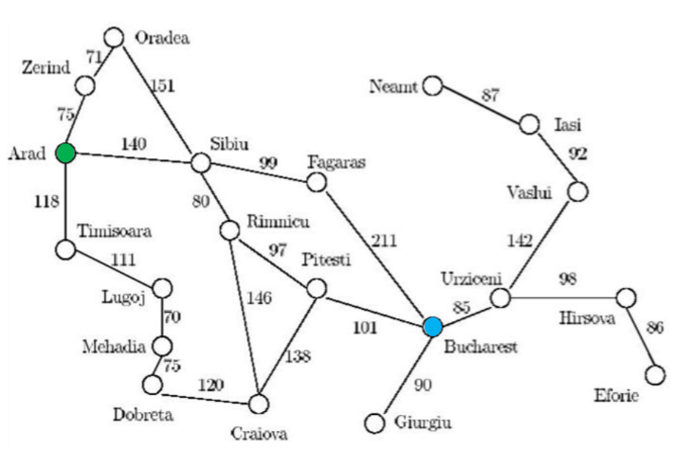
1. Given the Arad/Bucharest route finding problem and the heuristics table below, show the list n of visited nodes using the following search techniques:
1 – Breadth first
2- Depth first

Slide 104
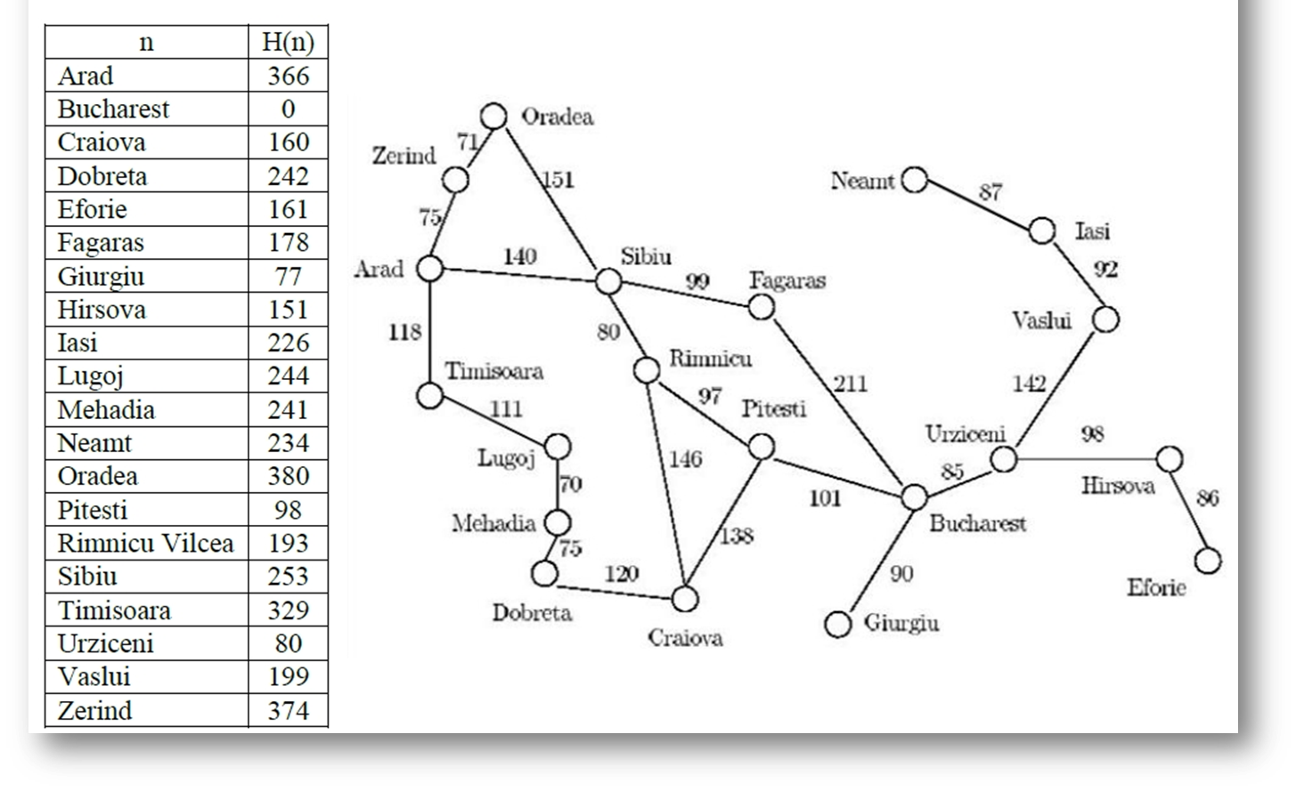
1. Given the Arad/Bucharest route finding problem and the heuristics table below, show the list n of visited nodes using the following search techniques:
1 – Breadth first
A

Slide 105
1. Given the Arad/Bucharest route finding problem and the heuristics table below, show the list n of visited nodes using the following search techniques:
1 – Breadth first
A
S
T
Z

Slide 106
1. Given the Arad/Bucharest route finding problem and the heuristics table below, show the list n of visited nodes using the following search techniques:
1 – Breadth first
A
S
T
Z
F
O
R

Slide 107
1. Given the Arad/Bucharest route finding problem and the heuristics table below, show the list n of visited nodes using the following search techniques:
1 – Breadth first
A
S
T
Z
F
O
R
L

Slide 108
1. Given the Arad/Bucharest route finding problem and the heuristics table below, show the list n of visited nodes using the following search techniques:
1 – Breadth first
A
S
T
Z
F
O
R
L
O

Slide 109
1. Given the Arad/Bucharest route finding problem and the heuristics table below, show the list n of visited nodes using the following search techniques:
1 – Breadth first
A
S
T
Z
F
O
R
L
O
B

Slide 110
1. Given the Arad/Bucharest route finding problem and the heuristics table below, show the list n of visited nodes using the following search techniques:
1 – Breadth first
A
S
T
Z
F
O
R
L
O
B
Order: A,S,T,Z,F,O,R,L,O,B
Path: A,S,F,B

Slide 111
1. Given the Arad/Bucharest route finding problem and the heuristics table below, show the list n of visited nodes using the following search techniques:
2 – Depth first
A
S

Slide 112
1. Given the Arad/Bucharest route finding problem and the heuristics table below, show the list n of visited nodes using the following search techniques:
2 – Depth first
A
S
F

Slide 113
1. Given the Arad/Bucharest route finding problem and the heuristics table below, show the list n of visited nodes using the following search techniques:
2 – Depth first
A
S
F
B
Order: A,S,F,B
Path: A,S,F,B

Slide 114
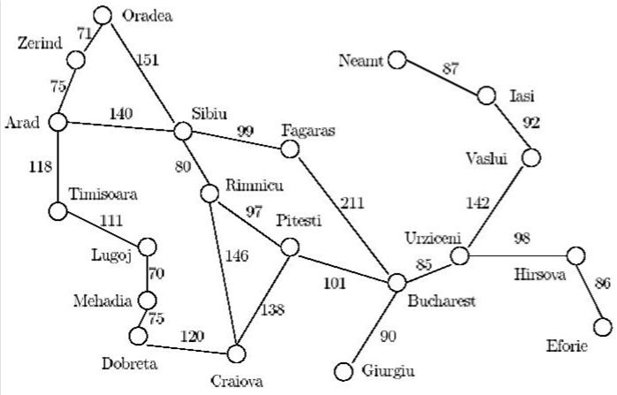
2. Given the Oradea/Lugoj route finding problem and the heuristics table below, show the list n of visited nodes using the following search techniques:
a) Breadth first
b) Depth First

Slide 115
Note :
The order is the steps you took to reach the goal (the nodes you visited till you reached the goal )
The path is the shortest way to the goal

